Slide 1
Cloud (PythonAnywhere)

Slide 2
Register for https://www.pythonanywhere.com/

Slide 3
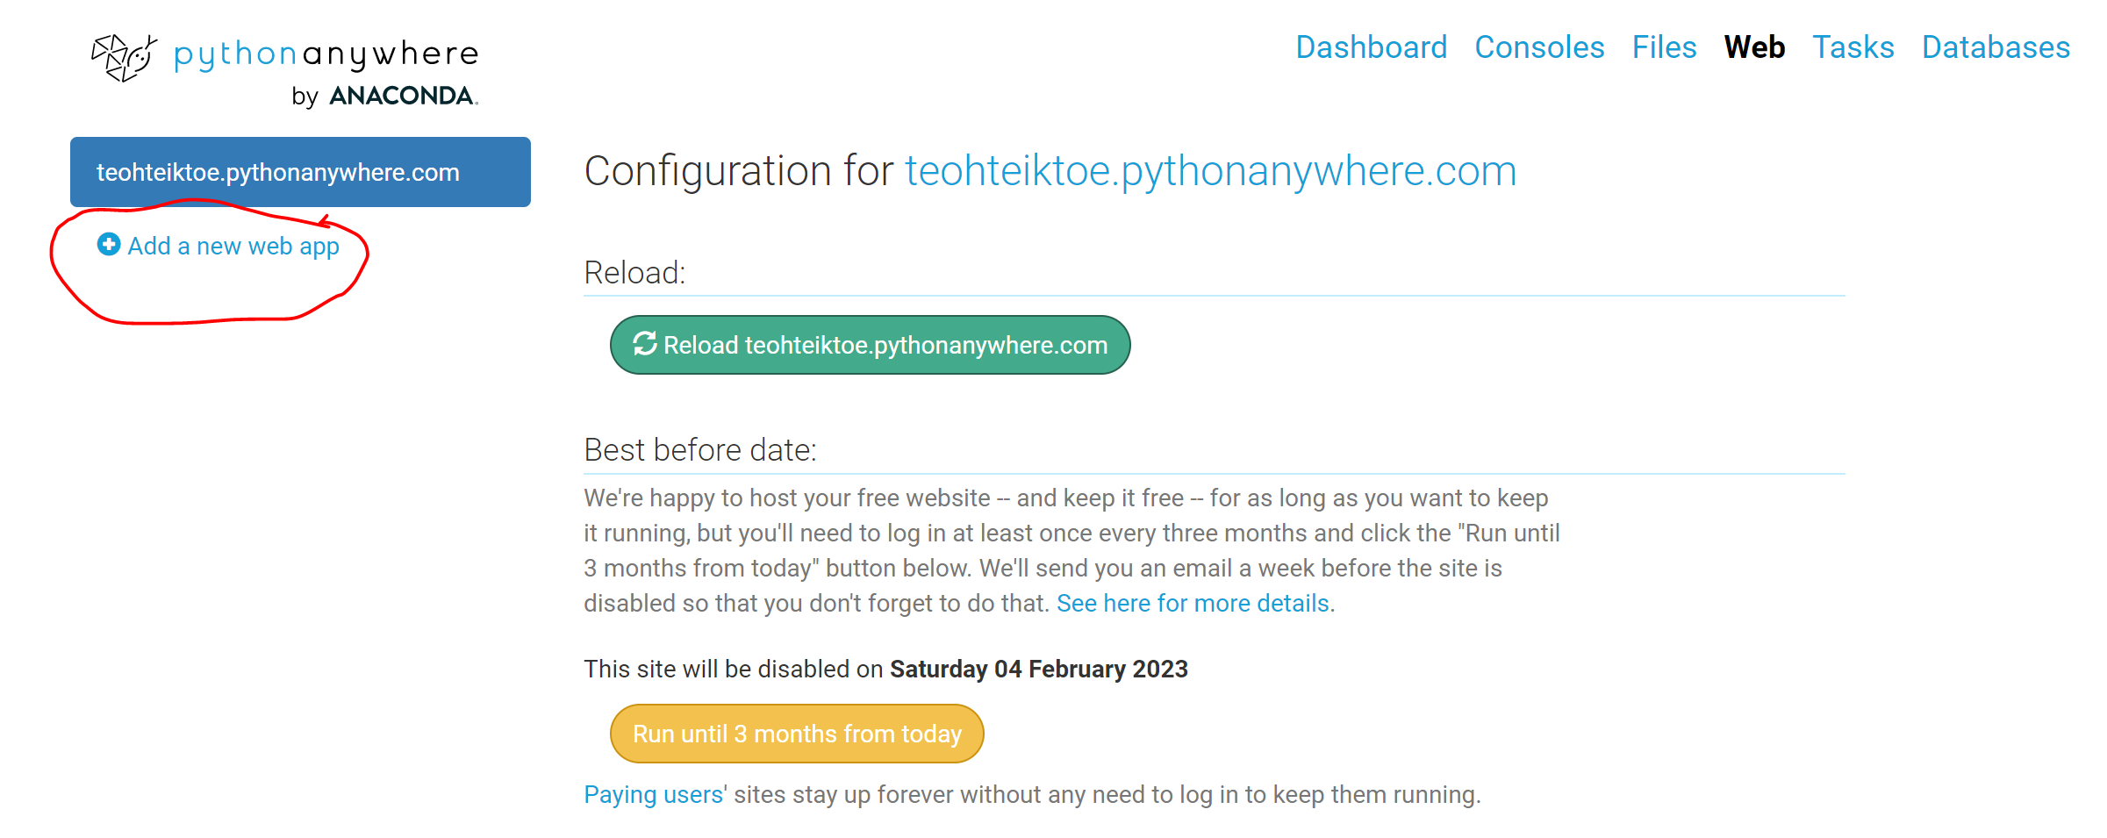
Add your new app to PythonAnyWhere:
Click on Add a New Web App button
Next -> Flask -> Python 3.10

Slide 4
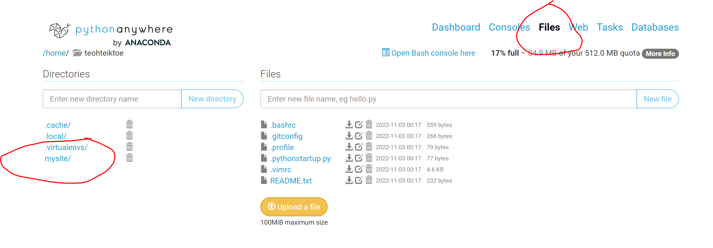
Upload your file

Slide 5
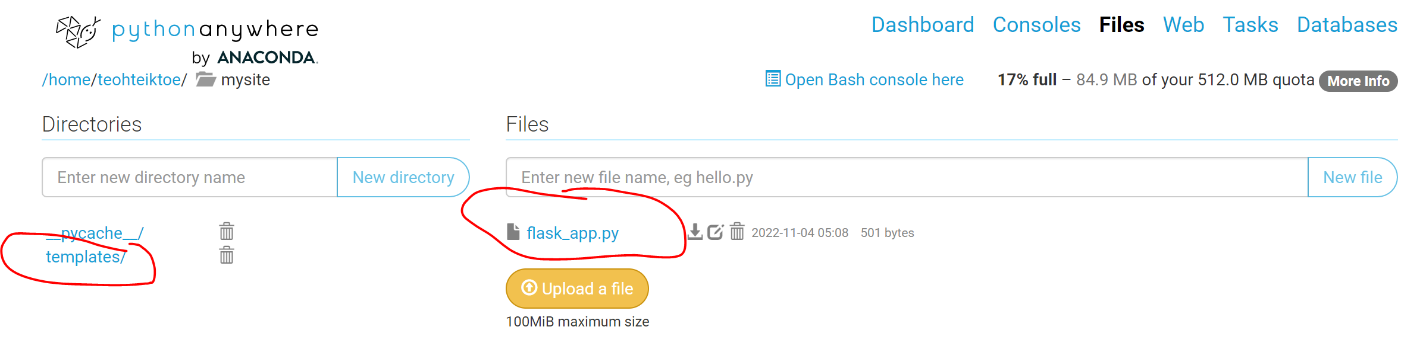
Upload your file

Slide 6
flask_app.py
from textblob import TextBlob
from flask import Flask,request, render_template
app = Flask(__name__)
@app.route("/", methods=["GET", "POST"])
def index():
if request.method == "POST":
text = request.form.get("text")
print(text)
s = TextBlob(text).sentiment
return(render_template("index.html", result = s))
else:
return(render_template("index.html", result = "waiting"))
if __name__ == "__main__":
app.run()

Slide 7
Index.html
<html>
<body>
<h2>Text Sentiment Analysis</h2>
<form action="/" method="post">
<P>Please upload the text in the text box: </P>
<p><input type="text" name="text"></p>
<p><input type="submit" value="Enter"></p>
</form>
<p>The sentiment score is {{result}}</p>
</body>
</html>

Slide 8
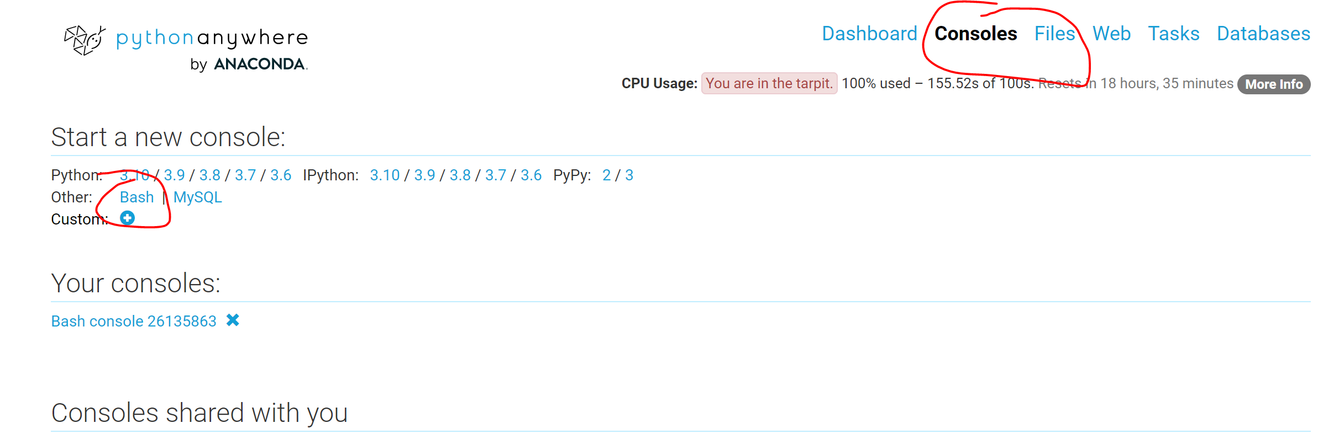
Virtual environment
To remove: rmvirtualenv myvirtualenv
Go to bash
mkvirtualenv myvirtualenv --python=/usr/bin/python3.10
pip install flask
pip install textblob

Slide 9
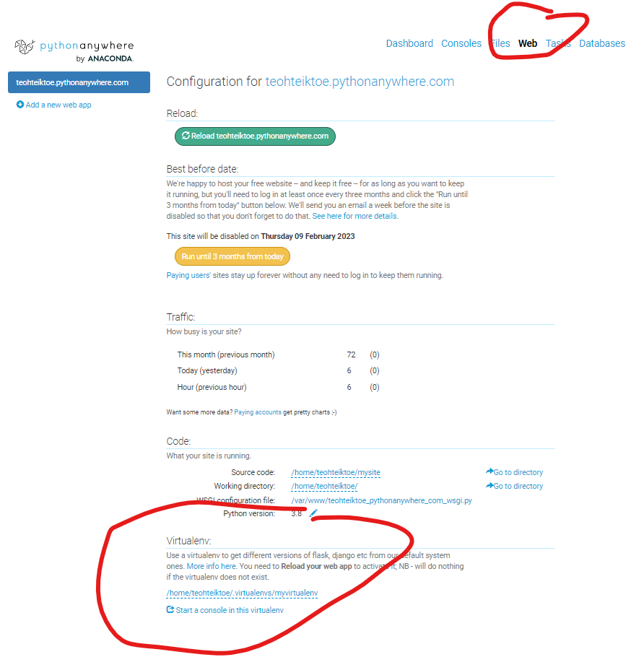
myvirtualenv

Slide 10
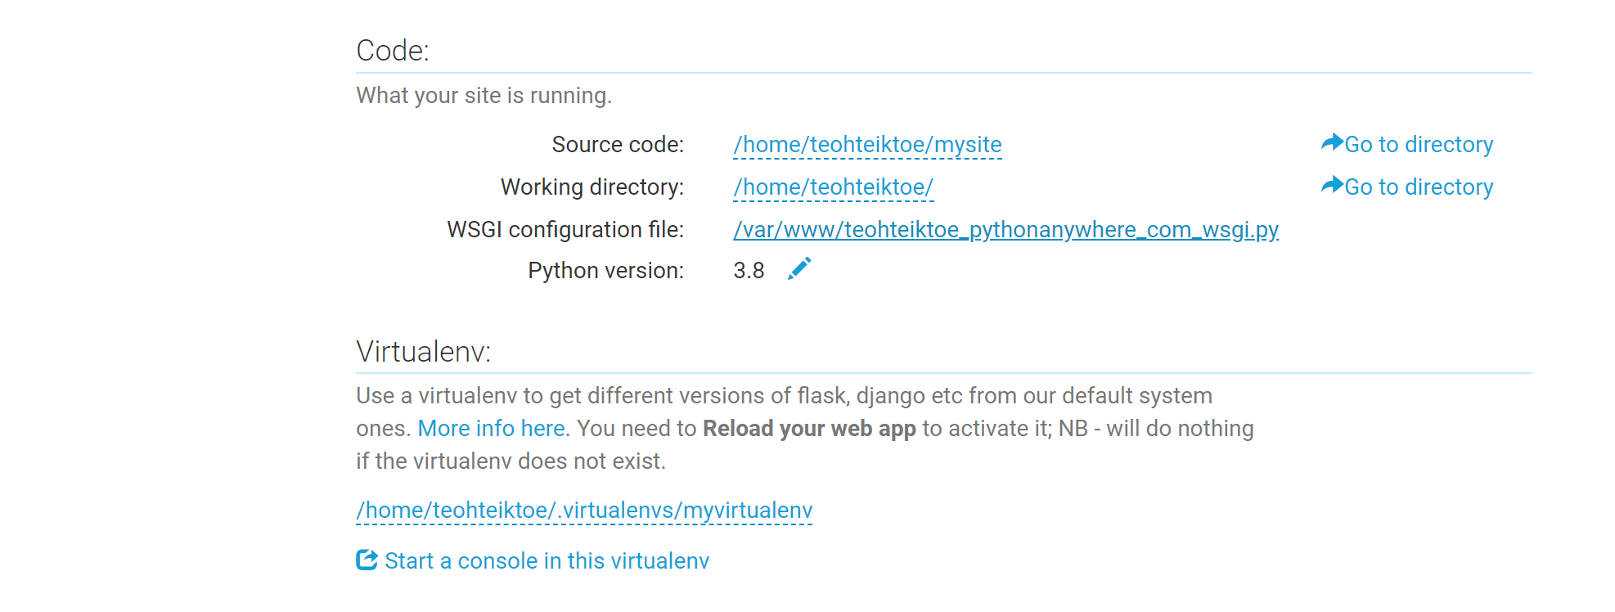
Configure your code

Slide 11
Understand wsgi (No changes needed)
import sys
# add your project directory to the sys.path
project_home = '/home/teohteiktoe/mysite’
if project_home not in sys.path:
sys.path = [project_home] + sys.path
# import flask app but need to call it "application" for WSGI to work
from flask_app import app as application # noqa
OUR PROGRAM NAME CALL flask_app

Slide 12
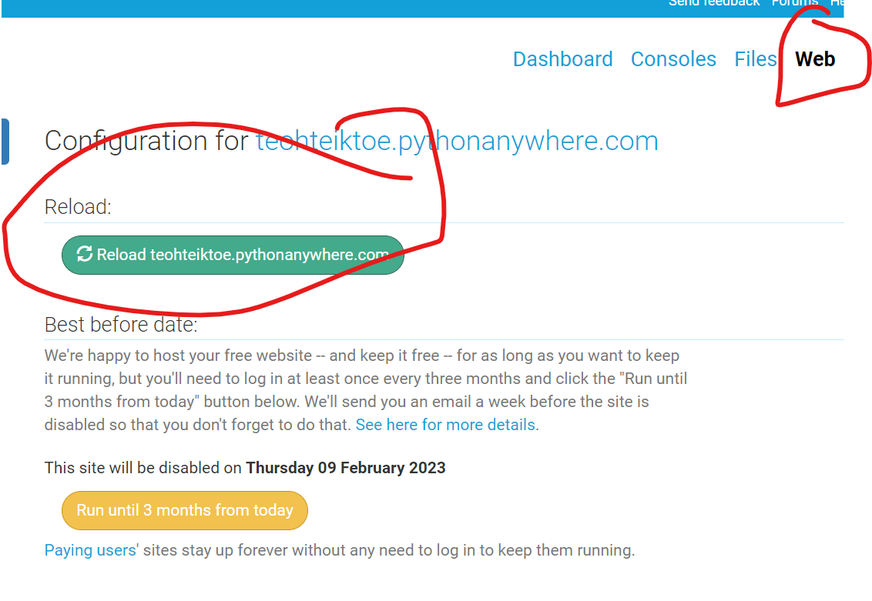

Run the program https://teohteiktoe.pythonanywhere.com/

